Slide 1
Case presentation by Hossam Khalafallah

Slide 2
M***m M****h
6 years old female patient from Al-baliana
presented to our out patient clinic may /2014 with history of yellowish discoloration of the skin &sclera , abdominal pain of one
month duration&pruritis of 5 years duration
No history of change in color of urine or stool

Slide 3
No past history of similar condition
No family history of similar condition
No history of bilharziasis
No history of drug intake
+ve consanguinty
There is no history of bleeding tendency

Slide 4
Examination
The patient looks ill & under weight
5th centile for age ))16 kg :Weight
25th centile for age))110 cm :Height
UL&LL:1st degree clubbing
Head & neck :jaundice and dark skin coloration
Chest & heart : clinically free
Abdomen :distention , spleenomegally( 6 cm below Costal margin
Neurolgical examination: clinically free

Slide 5
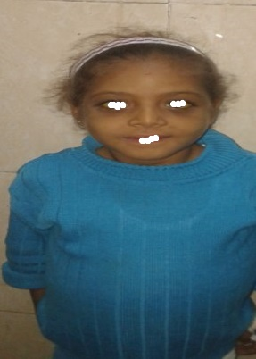

Slide 6
Clinical summary
6 y old female child with history of chronic jaundice , pruritis , abdominal pain , splenomegally and failure to thrive

Slide 7


Slide 8
Investigations
µL / CBC WBCS ------ 7000
Hb -------11.5 gm/dl
MCV -------95 fl
plt -------106→88
retic ------2.3 %
Liver functions ALT ------191→59 - AST------ 409→156
T.BIL-----8.8→9.8
D.BIL -----5→7.6
ALB -----2.7→ 1.5
ALP -------101

Slide 9
Hepatitis B serology → -ve
Hepatitis C serology → -ve
PT---PTT—PC-→ normal → prolonged
S.Creatinine →0.5 mg/dl
Urine analysis -→ normal

Slide 10
Abdominal ultrasound
Liver →normal size ,coarse echopatern ,
smooth surface
Spleen → mildly enlarged
Gall bladder → thick wall

Slide 11


Slide 12
Urinary CU →18 µg/24h ( N=15-70)
S. Ceruloplasmin → 25.6 mg/dl (n= 20-60)
Liver biopsy : chronic hepatitis , CU overload ,moderate activity ,moderate portal fibrosis

Slide 13
differential diagnosis

Slide 14
1- wilson`s disease
With→ liver biopsy findings
Against → normal urinary CU and serum ceruloplasmin
No Kayser–Fleisher ring
No neurological manifestations

Slide 15
2- indian childhood cirrhosis
It is a chronic liver diseas of childhood characterised by cirrhosis of liver due to deposition of copper in the liver It primarily affects children of 1–3 years of age and has a genetic predisposition.

Slide 16
Wilson`s disease
It is a rare autosomal recessive inherited disorder of copper metabolism that is characterized by excessive deposition of copper in the liver, brain, and other tissues
3 major patterns of hepatic involvement are as follows:
Chronic active hepatitis
Cirrhosis (the most common initial presentation)
Fulminant hepatic failure

Slide 17
Neuropsychiatric features
Frequent early symptoms include the following:
Difficulty speaking
Excessive salivation
Ataxia
Mask like facies
Clumsiness with the hands
Personality changes

Slide 18
Hematologic and renal manifestations
Coombs-negative acute intravascular hemolysis (10-15%)
Urolithiasis
Hematuria
Kayser-Fleischer rings
Formed by the deposition of copper in the Descemet membrane in the limbus of the cornea

Slide 19
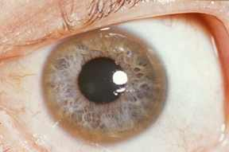

Slide 20
Cardiac manifestations rhythm abnormalities, increased autonomic tone
Skin pigmentation and a bluish discoloration at the base of the fingernails (azure lunulae)
The mainstay of therapy is lifelong use of chelating agents (eg, penicillamine, trientine)
Orthotopic liver transplantation is curative

Slide 21
Take home message wilson`s disease is a rare fatal disease if left untreated so it should be suspected in any case of hepatitis without a clear cause

Slide 22


